Slide 1
Office 365 Development

Slide 2
Course Agenda
Introduction to Office 365 Development
Module 1: Deep Dive Apps for Office in Outlook
Module 2: Deep Dive Apps for Office in Word
Module 3: Deep Dive Apps for Office in PowerPoint
Module 4: Deep Dive Apps for Office in Excel
Module 5: Deep Dive into SharePoint Hosted Apps
Module 6: Deep Dive into Provider Hosted Apps
Module 7: Deep Dive into Security and OAuth
Module 8: App Lifecycle Management

Slide 3
App Lifecycle Management

Slide 4

Agenda
Overview
Office 365 ALM
Office 365 Testing

Slide 5
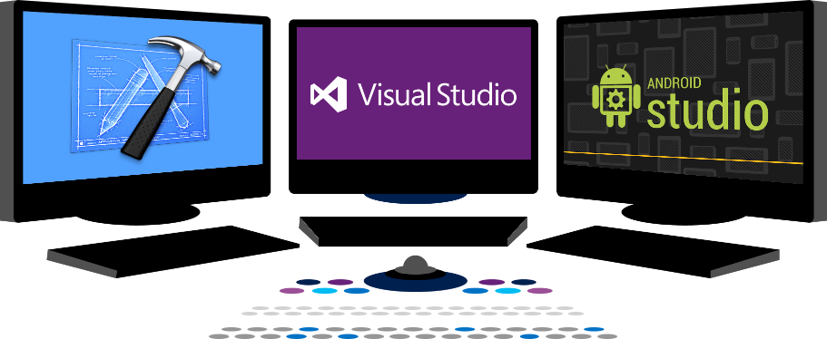














Vision
EXTEND OFFICE EVERYWHERE
CONNECT TO OFFICE 365 SERVICES
BUILD USING AN OPEN PLATFORM
Delve
z
Users and groups
Files
Mail
Calendar
My Apps
Video Portal
Contacts
Office Graph
Presentations
Documents
Spreadsheets
Lync
OneNote
Yammer

Slide 6
Overview

Slide 7
What is ALM?
ALM stands for Application Lifecycle Management
Key tenets:
A continuous process of managing the lifecycle of an application through governance, development, and maintenance
Integrating different teams, platforms, and activities
Enabled through a set of tools and processes
Visual Studio, Scrum
Notes:
This slide gives us the definition of ALM
A framework for managing the process
A way to integrate the work of team members
Enabled through a rich set of tools

Slide 8
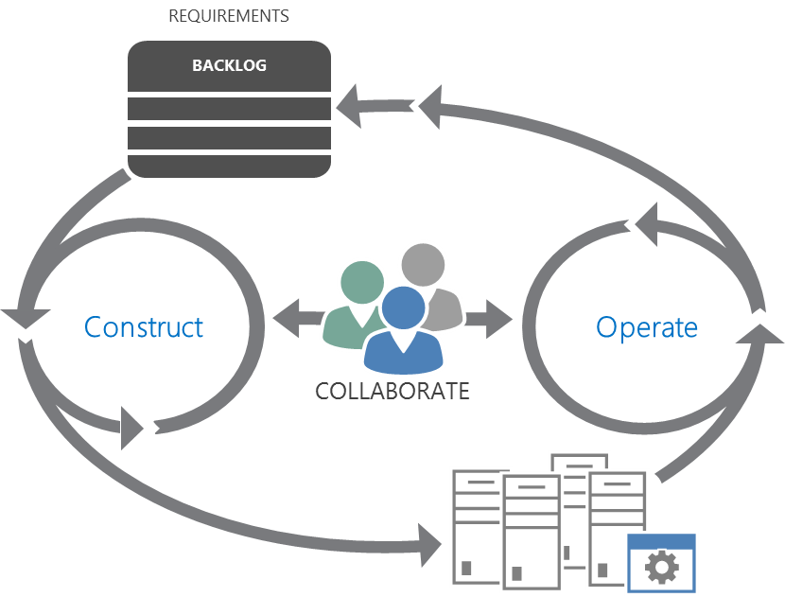
Lifecycle Overview
Plan
Monitor + Learn
Develop + Test
Release
Notes:
The modern ALM process is a continuous cycle
Plan, Develop, Test, Release, Learn
So, we need a rich toolset that can implement this process

Slide 9











Visual Studio 2013 ALM
Source Repos
Agile Planning
Team Rooms
Test Case Management
Feedback Management
Build and Continuous Integration
Team Foundation Server
Visual Studio Online
Notes:
Visual Studio is the key mechanism for implementing ALM
It sits on TFS, which has a core set of ALM capabilities
Source Control
Planning Tools with various processes (like Scrum) supported out-of-the-box
Team Rooms for collaboration support among developers and testers. Yammer-like messaging and alerts
Test Case development
Feedback management from users
Build and Continuous Integration
For Office 365 development, this is critical because there can be many moving parts such as apps, Azure, client-side, Web API, etc with different teams focused on different parts
Visual Studio Online
Is a cloud-based implementation of TFS
The value is that you don’t have to manage the operations on site

Slide 10
Work Item Tracking
Track work by category
Works with familiar tools
Visual Studio
Excel
Project
Customizable based on your individual needs
Fields, workflows, states customizable through process editor

Slide 11
Version Control
Use Team Foundation Version Control or Git
Integration with Work Items and Team Foundation Build – enables traceability back and forth.
Web Portal enables access to basic version control features.

Slide 12
Build Automation
Build Automation
Continuous Integration (CI)
Tightly coupled with other TFS components:
Version control
Work item tracking
Testing tools
Deployment
Lab management
Build code using Git
Propagates build results to data warehouse for historical reporting

Slide 13
Reporting
Built on SSRS and SSAS
Can customize existing reports or create custom reports
Available via SQL Server Reporting Services, Excel Reports, SharePoint dashboards, or Work Item Queries

Slide 14

Capabilities and Features
Plan
Agile portfolio management
Kanban customization
Work item tagging
Work item charting
Operate
Visual Studio and System Center integration
Performance events
REQUIREMENTS
BACKLOG
Build | Measure | Learn
Collaborate
Construct
Operate
Develop
Team Room
Git
CodeLens
.NET Memory Dump Analyser
Load testing as a service
RELEASE
Release
Integrated release management
Configuration- based deployments
WORKING SOFTWARE
Notes:
This is how the capabilities of TFS map to the modern ALM process

Slide 15
demo
Provider-Hosted App Source Control
Notes:
This is a Provider-Hosted app created from scratch under Visual Studio online TFS control.

Slide 16
Office 365 ALM

Slide 17
O365 ALM
Development Environments with Teams
DEV - Each developer gets O365 development sites in isolated tenant
TEST – isolated tenant for integration testing
Build Processes
Utilize Continuous Integration: automatically build on check in
Azure supports automatic deployment from TFS
Coded UI Build Verification Tests (BVTs) validate the build
Notes:
Each developer gets their own site so as not to interfere with others
Test is a separate tenant to support integration and cross-site collection capabilities
Using Continuous Integration ensures all changes are available following a check in
Azure can be configured to allow deployment following a build

Slide 18
Continuous Integration SharePoint Hosted App
SharePoint Online
Testing tenant or isolated site collection in production depending on app functionality
Visual Studio online or TFS
Storage of the source code
Automated builds
Coded UI / Build verification Tests
Deployment automation with PowerShell and build definitions
4
1
SharePoint On-Premises
Integration testing environment
Possible isolated site collection in production environment, depending on app functionality
2
3
Notes:
Code is checked in for the cloud or on-premises team foundation system
All automation is performed in the TFS side
Test execution and follow up using TFS tooling
Deployment of the SP hosted app to SharePoint can be automated suing PowerShell. SharePoint could be on-premises or cloud, really no difference on how the deployment will happen, except on exact technical details related on the PowerShell based automation for the authorization.

Slide 19
Continuous Integration Provider Hosted App
SharePoint Online
Testing tenant or isolated site collection in production depending on app functionality
Could be also on-premises SharePoint
Visual Studio online or TFS
Storage of the source code
Automated builds
Coded UI / Build verification Tests
Deployment automation with PowerShell and build definitions
4
1
5
Microsoft Azure
Provider hosted code is deployed as automated process to the cloud platform
Could be also on-premises or IAAS with private cloud setup
2
3
Notes:
Code is checked in for the cloud or on-premises team foundation system
All automation is performed in the TFS side
Test execution and follow up using TFS tooling
Deployment of the app file to the SharePoint, which could be on-premises or cloud. Notice that since the app file part does not change that often, you will only need to trust the app when there are changes either in the app web or in the needed oAuth permissions. Typically you don’t need to redeploy the app file to the SharePoint, which will make the process easier
Deployment of the actual provider hosted app to the provider hosted platform as PAAS, IAAS or on-premises setup. Since majority of the changes are applied on the provider hosted code side, this is the part which you’d be deploying as part of the automated builds. App file only when needed.

Slide 20
demo
Continuous Integration

Slide 21
Office 365 Testing

Slide 22
O365 Testing Considerations
Tenants can be different versions
APIs between versions will be subject to roll out schedules
Testing environment should be in the same tenant as “production”
App project and Web project are dependent and should be tested together
Notes:
Again, tenants can be at different versions in O365
Remember that the app web and remote web are dependent and should be tested together

Slide 23
Testing process in high level
SharePoint Online
Testing tenant or isolated site collection in production depending on app functionality
Could be also on-premises SharePoint
Execute Tests
<<deploy app>>
C#
3
<<deploy app>>
1
2
Microsoft Azure
Provider hosted code is deployed as automated process to the cloud platform
Could be also on-premises or IAAS with private cloud setup
4

Slide 24
Testing with multiple environments
Integration testing
Isolated separate tenant or site collection depending on the app specifics
For frequent automated testing
Visual Studio online or TFS
Storage of the source code
Automated builds
Coded UI / Build verification Tests
Deployment automation with PowerShell and build definitions
2
<<deploy app>>
3
Build definition
User acceptance / Quality assurance
Isolated separate tenant or site collection depending on the app specifics
For user acceptance before production usage
1
<<deploy app>>
Release manager
4
5

Slide 25
demo
Build Verification Testing

Slide 26
Summary
Overview
Office 365 ALM
Office 365 Testing

Slide 27


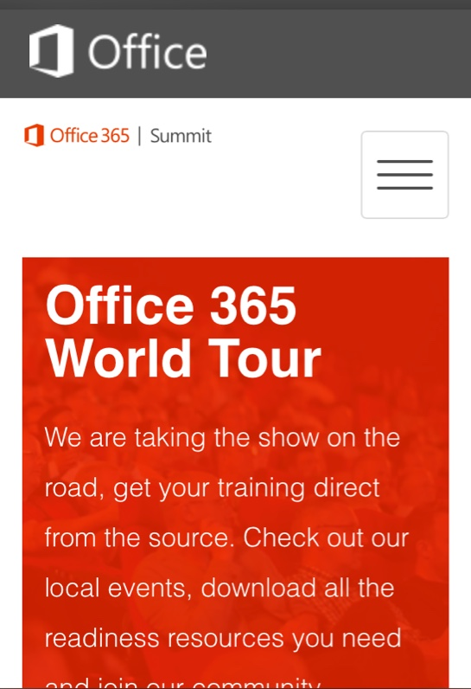
dev.office.com
Sign up
http://dev.office.com/getting-started
Explore
http://apisandbox.msdn.microsoft.com
Get trained http://dev.office.com/training

Slide 28


Feedback
Office 365 Network Share you best practices and join conversations https://www.yammer.com/itpronetwork
Stackoverflow Ask deep technical questions to a world-wide set of developers
http://stackoverflow.com/questions/tagged/ms-office
UserVoice Provide suggestions of what you want in future versions
http://officespdev.uservoice.com/

Slide 29

© 2012 Microsoft Corporation. All rights reserved. Microsoft, Windows, and other product names are or may be registered trademarks and/or trademarks in the U.S. and/or other countries.
The information herein is for informational purposes only and represents the current view of Microsoft Corporation as of the date of this presentation. Because Microsoft must respond to changing market conditions, it should not be interpreted to be a commitment on the part of Microsoft, and Microsoft cannot guarantee the accuracy of any information provided after the date of this presentation. MICROSOFT MAKES NO WARRANTIES, EXPRESS, IMPLIED OR STATUTORY, AS TO THE INFORMATION IN THIS PRESENTATION.

